Slide 1

Amazon Web Services
workshop
for System Engineer
Using Amazon Machine Image (AMI)

Slide 2
Topics
Understand of Amazon Machine Image
Create Snapshot
Create Amazon EC2 from your AMI

Slide 3
Objectives
You will be able to
Install software on Amazon EC2
Create EC2 Snapshot
Create EC2 instances from your AMIs.

Slide 4
Amazon Machine Image (AMI)
An Amazon Machine Image (AMI) provides the information required to launch an instance, which is a virtual server in the cloud.
You specify an AMI when you launch an instance, and you can launch as many instances from the AMI as you need. You can also launch instances from as many different AMIs as you need.
An AMI includes the following:
A template for the root volume for the instance (for example, an operating system, an application server, and applications)
Launch permissions that control which AWS accounts can use the AMI to launch instances.
A block device mapping that specifies the volumes to attach to the instance when it's launched

Slide 5
AWS Marketplace
AWS Marketplace helps software buyers easily find software that matches their needs.
AWS Marketplace lets buyers choose from a broad set of software offerings that provide both varied functionality and varied purchase options.
If a customer already has a license, they should be able to easily run the software on Amazon Web Services (AWS), without paying for the software again.
If a customer discovers software on AWS Marketplace that they do not have rights for, they should easily be able to gain access to that software by buying the rights directly via AWS Marketplace.

Slide 6
Pricing AMI Products
Category | Pricing Option | Description
No Charge | No charge | Buyers are allowed to run an unlimited number of instances of your software, except as limited by Amazon EC2.
Bring Your Own License (BYOL) | BYOL | Buyers acknowledge that they already have the license required to use this software. Buyers do not incur software charges. *
Fee-based | Choose from among fee-based options | Options: Buyers pay a monthly usage fee. Buyers pay an hourly usage fee. Buyers pay an hourly rate plus monthly usage fee. Note: The charges can vary by instance type **
*If any customer already owns a license to deploy your software, they can use the license they own to deploy your software on AWS servers, as long as they certify that they have the required license to do so (BYOL). AWS Marketplace does not provide additional validation beyond what you have already built into your software.
**AWS Marketplace supports instance types available in Amazon EC2. For the most current list of EC2 instance types, see Instance Families and Types in the Amazon EC2 documentation.

Slide 7
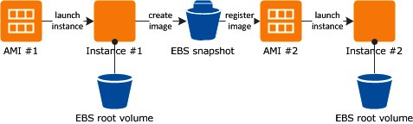
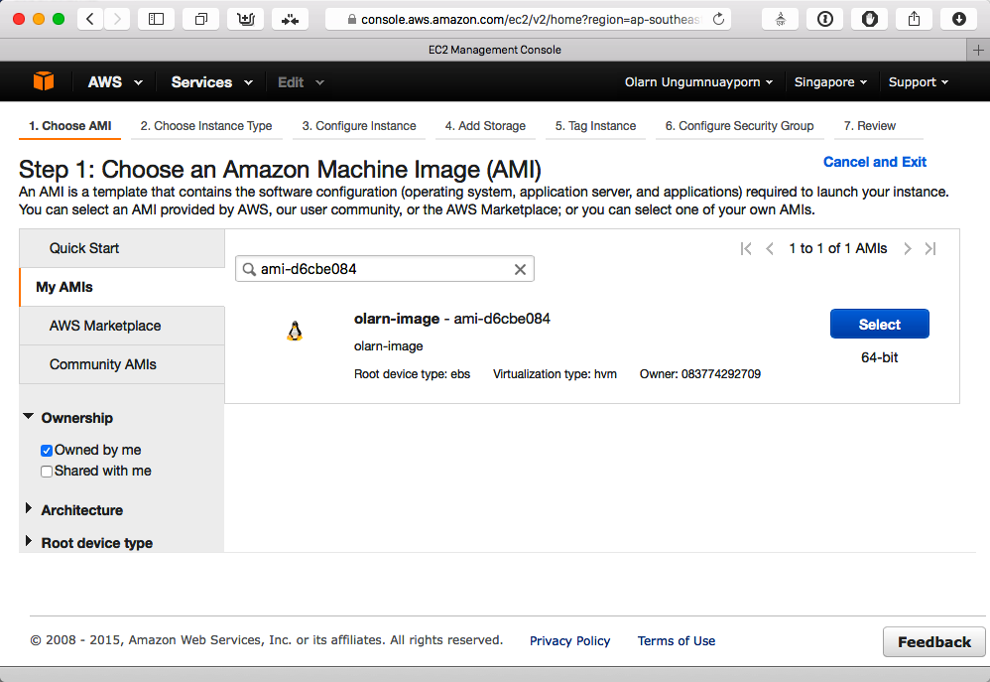
Creating an Amazon Machine Image
To create an AMI
Start from an instance that you've launched from an existing Amazon EBS-backed Linux AMI.
Customized the instance to suit your needs, create and register a new AMI.
Launch new instances with these customizations

Slide 8
Lab: Create Your EC2 AMI
Overview
This guide introduces you to Amazon EC2 snapshot, register AMI and create Amazon EC2 instance from your AMI.
4 labs.
Topic Covered
Install Node.js and Node-RED on Ubuntu Server
Create Node-RED flow and save POST message from client to MongoDB.
Create EC2 snapshot.
Create EC2 instance from your AMI.
Note:
Do not delete your AMI. It will be used again in the Auto Scaling lab.

Slide 9
Lab 1-4: Install Pre-requisites
Remote to EC2 instance with PuTTY or SSH client.
Update OS
Install Node.js, Git
Test Node.js
> sudo apt-get update
> sudo apt-get upgrade -y
> sudo apt-get install software-properties-common python-software-properties git -y
> sudo add-apt-repository ppa:chris-lea/node.js
> sudo apt-get update
> sudo apt-get install nodejs -y
> sudo apt-get autoremove
> node -v
> npm -v

Slide 10
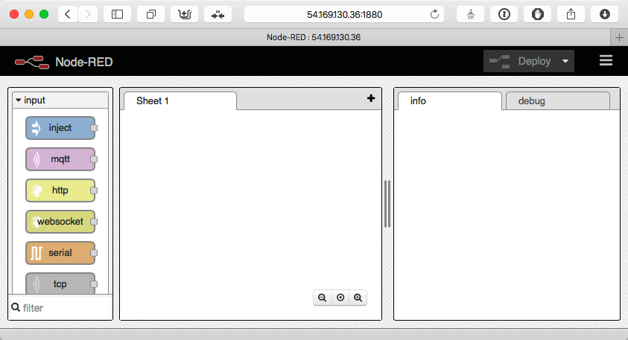
Lab 1-4: Install Node-RED
Clone Node-RED from GitHub
Install Node.js package for Node-RED
Start Node-RED
Open browser on client and browse to http://<ec2_dns>:1880. You can see Node-RED main page.
> git clone https://github.com/node-red/node-red
> cd node-red
> npm install
> npm install mongodb
> node red

Slide 11
Lab 1-4: Create Node-RED Startup Script
On the Terminal application or PuTTY, press Control+C on keyboard to stop Node-RED.
Install forever package for Node.JS
Create start up script for Node-RED (copy and paste script below into nano)
> sudo npm install forever -g
> sudo nano /etc/init/node-red.conf
start on startup stop on shutdown
expect fork
script PATH=/opt/node/bin:$PATH exec forever start /home/ubuntu/node-red/red.js flow.json end script
pre-stop script PATH=/opt/node/bin:$PATH exec forever stop /home/ubuntu/node-red/red.js flow.json end script
Press Control+O to save (press enter to confirm file name), then press Control+x to exit.

Slide 12
Lab 1-4: Test Startup Script
Exit from the Terminal application or PuTTY.
Open EC2 Management Console, choose your instance, choose menu Actions > Instances State > Reboot, click Yes, Reboot button.
After EC2 instance back online. Open browser and connect to http://<ec2_dns_name>:1880 again to confirm everything is work correctly.

Slide 13
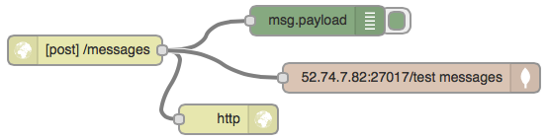
Lab 2-4: Add Node-RED Flow
Copy script below, click the menu button at the top-right corner, choose Import > Clipboard, then paste it into the nodes box, click OK button, then click anywhere to drop nodes on the node designer.
[{"id":"bf737f91.408c8","type":"mongodb","hostname":"52.74.7.82","port":"27017","db":"test","name":""},{"id":"cbf8cd83.34073","type":"http in","name":"","url":"/messages","method":"post","x":203,"y":102,"z":"8495d43f.7b6a28","wires":[["8a1e8620.75e178","ccd9ca66.332638","ddf9d787.220628"]]},{"id":"8a1e8620.75e178","type":"http response","name":"","x":348,"y":172,"z":"8495d43f.7b6a28","wires":[]},{"id":"ccd9ca66.332638","type":"debug","name":"","active":true,"console":"false","complete":"false","x":438,"y":72,"z":"8495d43f.7b6a28","wires":[]},{"id":"ddf9d787.220628","type":"mongodb out","mongodb":"bf737f91.408c8","name":"","collection":"messages","payonly":true,"upsert":false,"multi":false,"operation":"store","x":533,"y":130,"z":"8495d43f.7b6a28","wires":[]}]

Slide 14
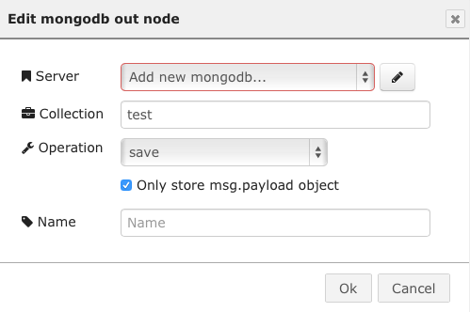
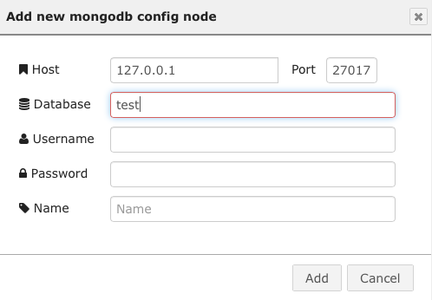
Lab 2-4: Configure MongoDB node
Double-click on MongoDB node (the brown one).
Select Only store msg.payload object check box.
Enter test for Collection.
Change Server drop-down list to Add new mongoldb…, and click the edit button on the right-hand side.
In the Add new mongodb config node dialog,
Enter your EC2, that running MongoDB, IP Address
Enter test in the Database field.
Click Add button
Click Ok button to save change.
Click Deploy button. Note: Leave the browser open to see the result at the end of this lab.

Slide 15
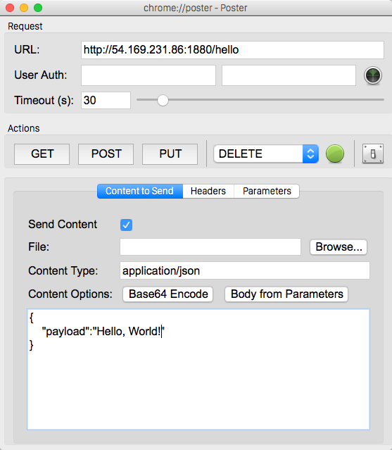
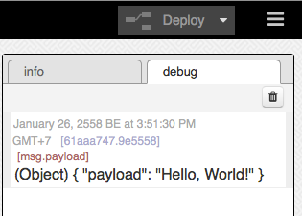
Lab 3-4: Test Node-RED Flow
Open Firefox Poster, enter…
url - http://<ec2_dns>:1880/test
Content Type - application/json
Body:
Click POST button.
Back to the browser. You will see the payload message from client in the debug tab in Node-RED designer.
{
"payload":"Hello, World!"
}

Slide 16
Lab 3-4: Check posted data in MongoDB
SSH to MongoDB EC2 instance. Type mongo to open MongoDB shell.
> mongo
>> show dbs // to show all database inside MongoDB. // you should see “local” and “test”.
>> use test // use database named “test”.
>> show collections // display all collections inside test database. // you can see collection named “messages”.
>> db.messages.find() // display all documents inside collection “messages” // you should see posted document
In MongoDB shell…

Slide 17
Lab 4-4: Create EC2 Snapshot
Open EC2 Management Console. Choose your EC2 instance, open menu Actions > Image > Create Image.
In Create Image dialog, enter image name and image description as your name (like <your_name>_img) and change size to 8GB.
Click Create Image button. Note:
AWS will shutdown your instance and create you EC2 snapshot.
You can prevents AWS to reboot your instance by click No reboot. When enabled, Amazon EC2 does not shut down the instance before creating the image. When this option is used, file system integrity on the created image cannot be guaranteed.
This process may takes a few minutes.

Slide 18
Lab 4-4: Create EC2 Instance from you AMI
From EC2 Management Console, click the AMIs menu under Images group. You can see your AMI created in step 3.
Choose your AMI, choose menu Actions > Launch.
Follow the create instance wizard.
In Step 5, provides <your_name>_2 for instance name and enter <your_name>_group for Group name.
In Step 6, choose Select an existing security group, then choose security group Node-RED (created from the previous chapter)
In Step 7, in the Select key pair dialog (after click Launch button), choose an exist key pair and choose your created key from previous chapter, click check box I acknowledge…, then click Lunch Instances button.
Click View Instances button, you can see a EC2 new instance is provisioning. Wait until your instance state changes to running, then use browser connect to http://<new_ec2_dns>:1880. You should see Node-RED design page.

Slide 19
Conclusion
Congratulation! You’re finished this lab. In this lab, you:
Install software (node.js, Node-RED) on the EC2 Instance (Linux).
Create Amazon Machine Image using AWS Management Console.
Create Amazon EC2 from your own AMI using AWS Management Console.

Slide 20
References
Amazon AMIs https://docs.aws.amazon.com/AWSEC2/latest/UserGuide/AMIs.html
Pricing, Listing and Updating AMIs https://aws.amazon.com/marketplace/help/200940380
Create an AMI EBS-Backed https://docs.aws.amazon.com/AWSEC2/latest/UserGuide/creating-an-ami-ebs.html
Node.JS http://nodejs.org
Node-RED http://nodered.org

